Slide 1
cBay Pickleball Setting up the Pickleball Net Instructions
October 2020

Slide 2
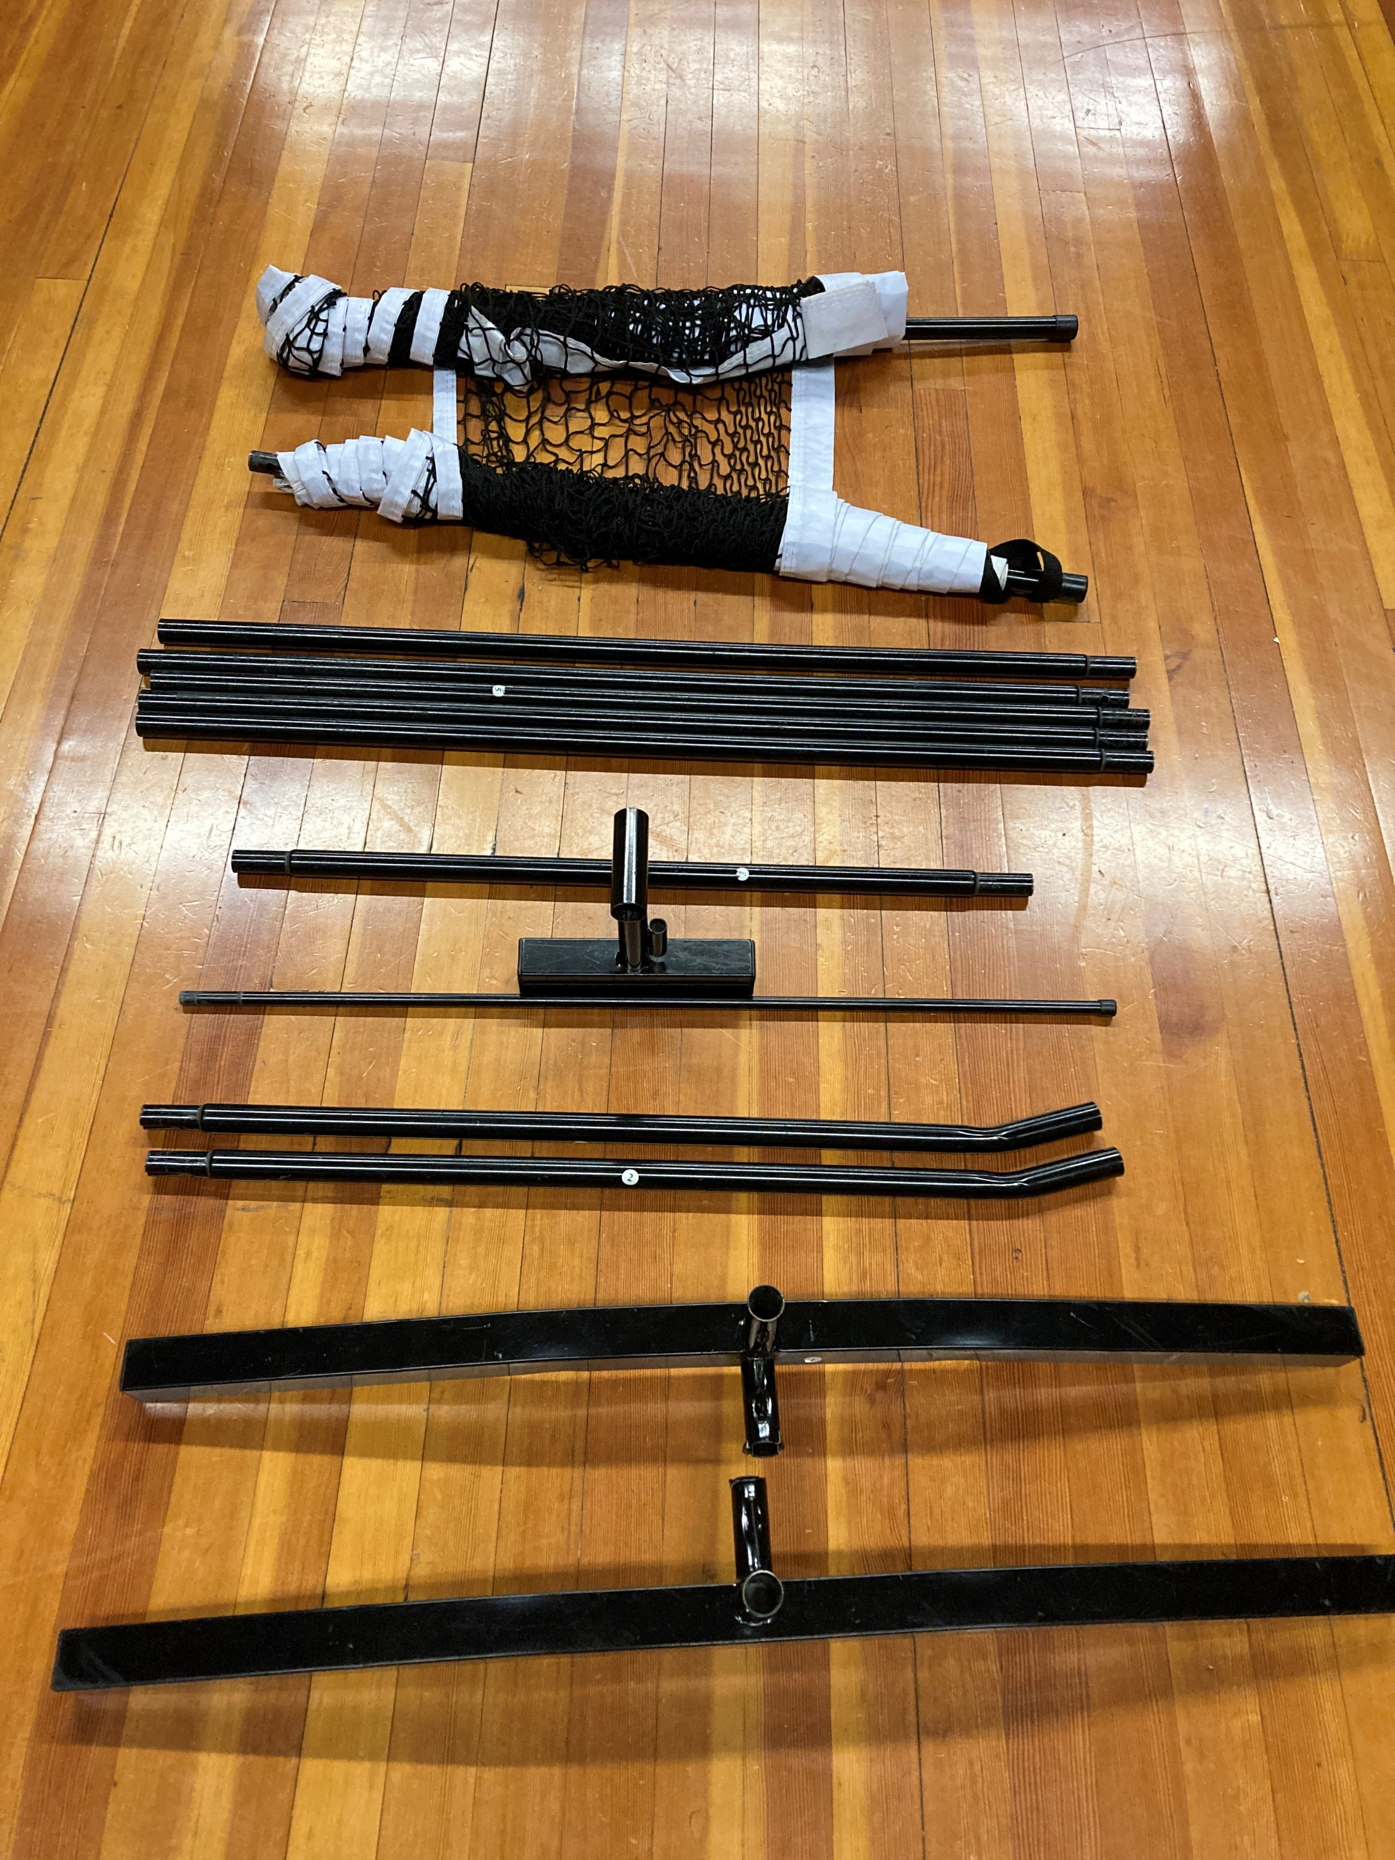
Contents of Net Travel Bag
Net Posts – x 2
Net – x 1
Long Tubes – x 5
Transition Tube – x 1
Center Post Stand – x 1
Short Riser Tubes – x 2
End/Net Post Stands – x2

Slide 3
Building the Net Framework
Start with the Net end stand
Insert riser tube
Install Transition Tube
Install long tubes
Add Center Post stand after 3rd long tube
Insert remaining riser tube to long tube and to Net end stand

Slide 4
Positioning Net Frame on Court
Place court frame at mid-court with the tubing aligned with the net post holes directly below the frame
The court measures 20 feet in width and the net is 21 feet long – the net will be approximately 6 inches outside of either side of the court side lines
Ensure that the entire net frame is straight and doesn’t have any turns or curves – straighten as needed
Align the Center Net post to be aligned with the middle line of the court
Prepare to install net posts and net

Slide 5
Installing Net Posts & Net
Lay out the net along side of the net frame
Install one net post with net attached into one of the End Stands
Push the Net down the post until the top of the nest is approximately 4-6 inches up the Net Post
Make sure none of the Net will be caught up in the bevel of the Net Post
To install the other Net Post, take the Post and Net to the other End Stand
Place the end of the Net Post on the floor and push the Net down to end of the Net Post
Clear the bevel end of the Net Post of any netting
Insert the Net Post into the End Stand until the post is securely inserted
Raise the net to the top of the net posts just below the net post cap, repeat on opposite end
Free up any net mesh caught in the Center Net Stand

Slide 6
Installing the Center Net Post
Take
Take the Center Post and insert into the sleeve
Ensure that the “capped” end of the post is inserted into the sleeve
Push
Push the post into the sleeve until it is in the top of the Net
Insert
Insert the bottom end of the Center Post into the Center Post Stand
Align
Align the Center Post Stand to the mid-court lines on one side of the playing surface – adjust accordingly
Align
Align the Net Post (grab hold of the top of the net where the net post is located) and slide the Net Post to be in-line with the center of the courts

Slide 7
Tighten the Straps – Net Post
Tighten the straps on the End Net Posts

Slide 8
Things That Go Wrong
Tension Straps too low on Net Post
Tension Straps not ready to tighten

Slide 9
